Slide 1
Session 4: Integrated Planning
Dr Andre Samuel
andre.samuel@sam.edu.tt

Slide 2
Learning Outcomes

Slide 3
Why Integrated Planning?

Slide 4
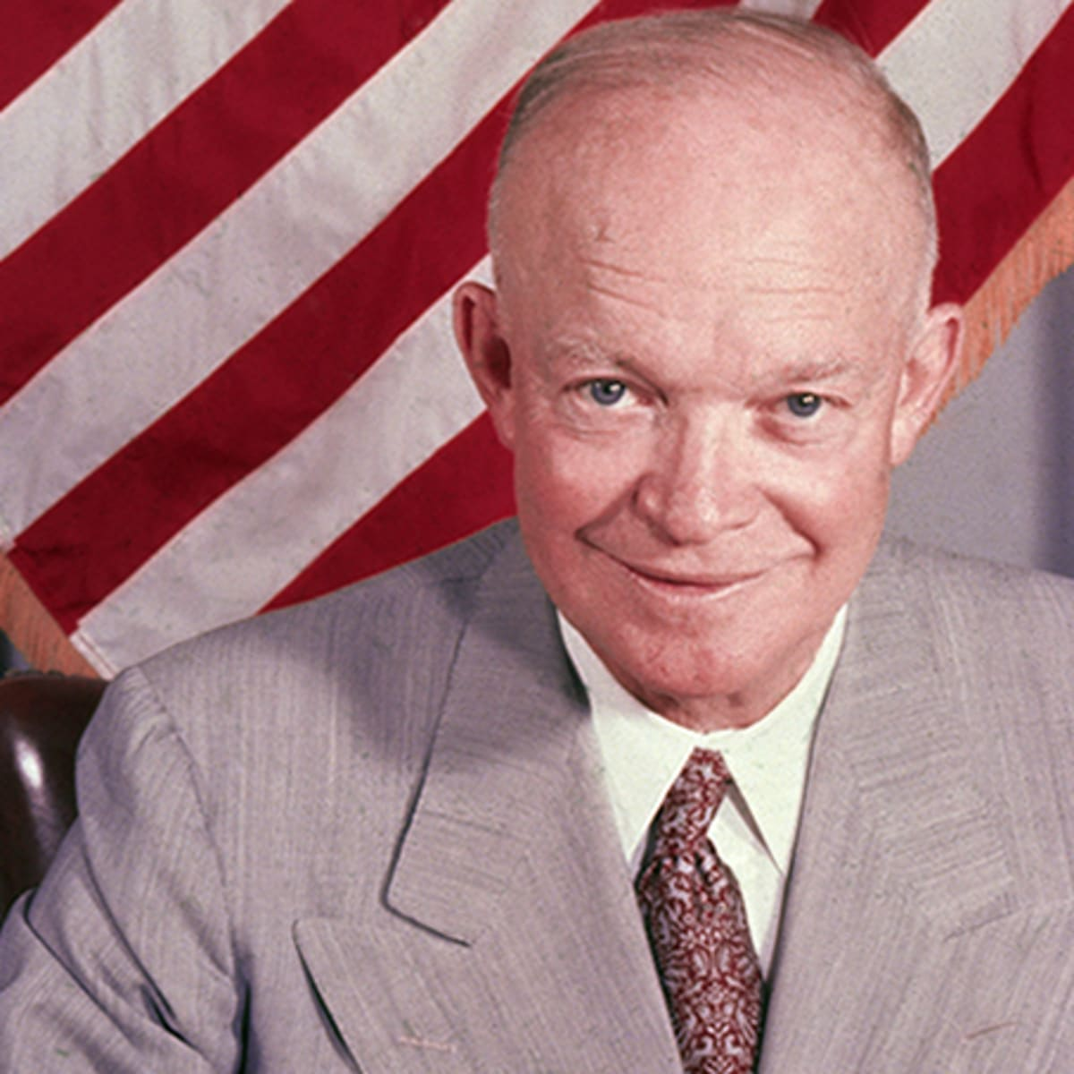
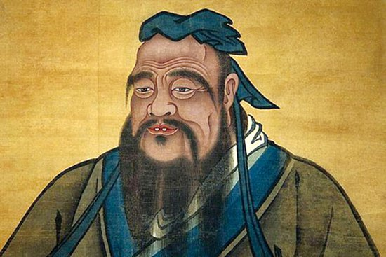
Different perspectives on planning
(selection from Hughes, 2018)
By failing to plan, you are planning to fail
Plans are useless, but planning is essential
A man who does not think and plan ahead will find trouble at his door
Dwight D. Eisenhower
Benjamin Franklin
Confucius
I’m not Martin Luther King, I don’t have a dream, I have a plan.”
Have a bias towards action – let’s see something happen now. You can break that big plan into small steps and take the first step right away.
Spike Lee
Indira Gandhi
Notes:
“By failing to plan, you are planning to fail.” – Benjamin Franklin
“Plans are useless, planning is worthless.” - Dwight D Eisenhower
“A man who does not plan long ahead will find trouble at his door.” – Confucius
“Good fortune is what happens when opportunity meets with planning.” – Thomas Edison
“Before anything else, preparation is the key to success.” – Alexander Graham Bell
“I ain’t Martin Luther King. I don’t need a dream. I have a plan.” – Spike Lee

Slide 5
Why plan your project? Can’t you just do it!
Planning makes us think.
Analyse and consider different ways to make change
Evaluate constraints, problems
= Valuable knowledge and understanding to
Planning gives you a place to start – plans will need revising and changing, but you do need one!
Without a plan – how can your team know what to do? Planning creates a shared vision and clarity on the direction
At the beginning of your project, planning is essential to practice collaborating and working together.
But, unfortunately, project planning is not a one and done process

Slide 6
I have a plan!
Marvel's Guardians of the Galaxy clip - 12 percent of a plan | HD - YouTube

Slide 7
In a situation, where uncertainty is high, Maylor (2017)
Detailed requirements may not be known in advance
Project manager has to deal with uncertainty
….it is difficult to plan
This is where…
comes in and a more agile approach is needed (i.e. 12% of a plan is better than nothing!)
Tailoring the lifecycle
Emergence and uncertainty
Project Characteristics

Slide 8
Planning can help and hinder (Figure 5.5 from Maylor, 2017 (p. 103))
Costs
Plan is a straitjacket
Focus on precision
Generation of data
Benefits
Good use of planning
Plan as a working tool
Focus on accuracy
Provision of information
Misuse of planning
Good use of planning

Slide 9
The Project Management Plan

Slide 10
Project Management Plan (PMP)
WHO
For Example
Project organisation
Project team organisation
Organisational chart
WHY
For Example
Project aims and objective
Business case
Benefits
WHERE
For Example
Delivery requirements
Site requirements and conditions
Shipping requirements
Major restrictions
HOW
For Example
Acceptance procedure
Configuration management
Communication management
Financial Management
Procurement strategy
Project approvals required and authorisation limits
Project implementation strategy
Health and safety
management
Risk Management
Quality management
Close out procedure
The Project Management Plan
Typical Contents
WHEN
For Example
Project life cycle
Key dates
Milestones
Gantt chart and network if available
Programme management
General
For Example
Executive summary
Contents, distribution and amendment record
Introduction
Project diary
Project history
WHAT
For Example
Scope
Project requirement
Management reporting system

Slide 11
The Project Management Plan
Time
Stakeholders
(week 3 and 4)
Time
Quality
Cost
Scope
Quality
(week 4)
Plan Quality Management
Quality
Plan Stakeholder Engagement
Cost
Scope
(week 4)
Time (week 4 and 5)
Plan Scope Management
Requirements
Define scope
WBS
Integrated Planning
(weeks 4 and 5)
Quality
Project Management Plan (PMP)
Stewardship & Governance
Cost
Scope
Plan Schedule Management
Define activities
Estimate durations
Sequence activities
Develop schedule
Risk
(week 6)
Team &
Organisation
(week 5)
Time
Plan Risk Management
Identify Risks
Quantitative Risk Analysis
Qualitative Risk Analysis
Plan Risk
Responses
Quality
Plan Resource Management
Estimate Activity Resources
Cost
(week 6)
Scope
Plan Cost Management
Estimate Costs
Determine Budget

Slide 12
BREAK
Take a 10 minute break, after the break…

Slide 13
Time Management
Schedule Development- Gantt Charts, Critical Path Analysis

Slide 14
The Time/Schedule Development Process
Identify Activities
Present Plan in a readily intelligible format
Determine Sequence of activities
Prepare Estimates of Time and Resources

Slide 15
Identifying Tasks

Slide 16
Requirements and Scope
Time
Stakeholders
Quality
Plan Stakeholder Engagement
Cost
Scope
Voice of the Stakeholders is integral to ensuring requirements are understood – recap from last week
Defining scope is providing a detailed description of the project and the product, otherwise stakeholders will have different views…
(Maylor, 2017 Figure 5.11 p. 113)

Slide 17
Scope creep
Time
Quality
Cost
Scope
Scope creep is “the uncontrolled expansion to product or project scope, without adjustments to time, costs, and resources.” (PMI, 2021, p. 249)
According to PMI’s (2021) Pulse of the Profession survey, 34% of projects experience it…
Wouldn’t it be great if….?
Could you just….?

Slide 18
What causes scope creep? (Viter, 2021)
Time
Quality
Cost
Scope
Poor communications (with client or project team)
Poorly or sparsely defined requirements
Missing documentation (single source needed)
Lack of change control
Long projects
Notes:
Poor communications
Client goes straight to team requesting ‘few’ changes (without PM knowing)
Poorly communicated project requirements to the team – going in a different direction
Poorly or Sparsely defined requirements
No time spent on this, fuzzy understanding. Unclear from beginning
Missing documentation
Single source team, customers, PM and stakeholders. Need specification or many ideas will come up, rather than being focused on objectives
Lack of change control
Small requests from customer (or stakeholder) can mean a lot more work, who is paying for it?
Long projects
Lots of uncertainty and also customer and stakeholders have more time to refine ideas

Slide 19
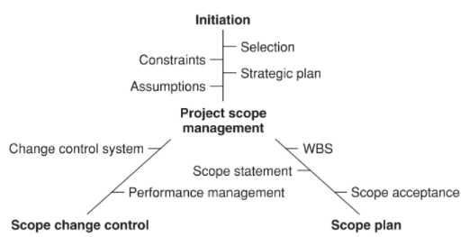
How can we manage scope creep?
Time
Quality
Cost
Scope
Clearly defined Product and/or Work Breakdown Structure (or statement of work according to Viter (2021))
Change control – project scope should be adaptable, but log changes, consider impacts on time, cost and resources, re-plan, manage the change
Stakeholder education and engagement throughout the project – they need to be an active part of the collecting requirements process and be updated on progress/status.
Distinguish between adjustment or new task
Keep in communication with your team – meetings, time sheets, etc.
(Maylor, 2017, Figure 5.4, p. 101)

Slide 20
Scope and Work Breakdown Structure
Monitoring &
Controlling Processes
Integrated Planning
Project Start Up
Project Close
Managing Deployment
Scope
Product scope: The features and functions that categorise the product, service or result
Project scope: The work performed to deliver a product, service or result with the specified features and functions.
Manage this by focusing on ensuring the project contains all the work required and only the work required for the project to be successful
Risk of scope creep
Usually shown in the Work Breakdown Structure

Slide 21
Work Breakdown Structure (WBS)
Time
Quality
Cost
Scope
Work Breakdown Structure - HOW
“A hierarchical decomposition of the total scope of work to be carried out by the project team to accomplish the project objectives and create the required deliverables.” (PMI, p. 81 and p. 187 and p.253)
Transforms requirements into work packages/tasks
Important for being on the “same page” with stakeholders and clarity for the project team
Basis for scheduling, resourcing and costing.

Slide 22
Work Breakdown Structure
Monitoring &
Controlling Processes
Integrated Planning
Project Start Up
Project Close
Managing Deployment
Work breakdown structure for a project to design an information interface for a new sales knowledge management system in an insurance company
Design information interface for new sales knowledge management system
1. Training
2. Installation
3. Testing
1.1 Form and train user group
1.2 Specify sales training
1.3 Roll[out training
2.1 Install systems infra-structure
2.2 Design initial screen interface
3.1 Test interface in pilot area
3.2 Modify interface

Slide 23
WBS Example: House Construction
1.0 House Construction
1.1
Planning
1.2 External Construction
1.3 Internal Construction
1.1.1.
Enlist an architect
1.1.2.
Finalise
blueprint
design
1.1.3.
Obtain planning permission
1.2.1.
Lay Foundations
1.2.2.
Construct external walls
1.2.3.
Construct
roof
1.3.1.
Construct internal walls
1.3.3.
Fit ceilings
1.3.4.
Fit windows and doors
1.3.2.
Lay flooring
1.3.5.
Install stairs
1.4.
Services
1.4.1.
Install plumbing
1.4.2.
Install electrics: power and lighting
1.4.3.
Install heating and air conditioning
1.5.
Decoration
1.5.1.
Plaster and paint walls
1.5.2.
Lay floor coverings
1.5.3.
Install kitchen
1.5.4.
Complete bathrooms
1.5.5.
Furnish the house
Aim is to scope the project into manageable work packages
Numbering shows the Parent task and the hierarchy

Slide 24
PBS Example: House Construction
House
Planning
External Construction
Internal construction
Architect
Contract
Architect’s Blueprint
Planning Permission Document
Concrete
Steel rods
Bricks
Plaster
board
Plaster
Windows
Wood
Doors
Services
Pipes and drainage
Taps
Boiler and radiators
Decoration
Plaster
Paint
Carpet
Tiles
Kitchen unit and accessories
Mortar
Roof tiles
Wood
Stair case
Plumbing essentials
Cabling
Electrical fixtures
Air conditioner
Bathroom units
Furniture and fittings
Water tank
Product Breakdown is used in manufacturing and system type projects – focus on WHAT
Scope the product to be produced by the project

Slide 25
Estimating Durations

Slide 26
Estimation Techniques
Ballpark – made only when vague information exists and when all details of the work have yet to be decided.
Analogy- uses actual cost of a previous , similar project as a basis for current project.
Parametric- this involves using project characteristics such as weight, volume, lines of software code, hours of contact and so on to predict project costs

Slide 27
Three Point Estimation
• Most likely (cM)- The cost of the activity, based on realistic effort assessment for the required work and any predicted expenses.
• Optimistic (cO)- The activity cost based on analysis of the best-case scenario for the activity.
• Pessimistic (cP)- The activity cost based on analysis of the worst-case scenario for the activity

Slide 28
Triangular Distribution.
cE = (cO + cM + cP) / 3
PERT Estimate
cE = (cO + 4cM + cP) / 6
Example- Estimating Durations:

Slide 29
Approaches to Estimation
Top-Down
Bottom-Up

Slide 30
Top-Down Estimating
Senior management sets budget
These are often fixed before detailed planning has taken place
The trigger is usually the strategic long term plan in response to their perception of organization’s goals and objectives
Major drawback is that the budget is rooted in senior management’s limited knowledge of specifics of the project
Detailed information is not available when preparing long term plan

Slide 31
Bottom-Up Estimation
Estimating cost of individual work items then rolling up the individual estimates to get a project total
It begins at the lowest level of detail and is gradually extended up through the WBS
Can only take place when a good project specification exists and a task list is compiled
Basically it utilize the WBS to develop a Cost Breakdown Structure (CBS)

Slide 32
Example of Bottom Up

Slide 33
BREAK
Take a 10 minute break, after the break…

Slide 34
Sequencing Tasks

Slide 35
Tasks Dependencies- sequencing activities
A relationship between two linked tasks
Linked by a dependency between finish and start dates
Defining task dependencies correctly results in a schedule that's easy to maintain regardless of what happens or how quickly
There are four types of dependency: Finish to Start, Start to Start, Finish to Finish and Start to Finish

Slide 36
Chronology vs Control
Although tasks are called either successors or predecessors, a dependency is not really about chronology, but about control.
A task dependency specifies which of two tasks controls the scheduling of the other.
The independent task (the predecessor) determines the scheduling of the dependent task (the successor).
A predecessor can occur before, at the same time as, or after its successor.

Slide 37
Task dependencies vs Date Constraints
Applying dependencies to tasks is preferable to setting hard dates in a schedule.
Fixed dates applied to tasks, called date constraints, quickly increase the effort to maintain the schedule.
If you use date constraints, you often must manually recalculate dates when the schedule changes.
However, date constraints don't always cause schedule problems.
For example, when tasks occur on specific dates, such as training classes or conferences, date constraints keep those events tied to the correct dates on the calendar.

Slide 39
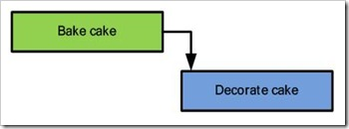
Finish-to-start (FS)
This type of dependency is the most common, perhaps because control and chronology work in the same direction in this dependency. After the predecessor task finishes, the successor task starts.
This means activity A must finish before activity B has permission to start
For example:
After members of a construction crew set up the concrete forms for a foundation, they start to pour the concrete into the forms.

Slide 40
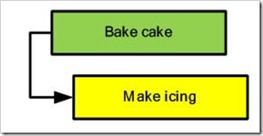
Start-to-start (SS)
This type of dependency indicates that the start of one task triggers the start of the second task. A lag time between tasks is often used with this type of dependency.
This means that once activity A has started, activity B can also start.
For example:
Members of a road crew start to place traffic cones to close a lane on the highway. Ten minutes (lag time), after they start the line-painting machine starts to paint lines.

Slide 41
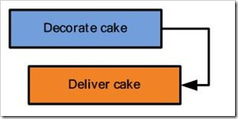
Finish-to-finish (FF)
This type of dependency includes one task that continues only as long as another task is in progress.
This means activity A must finish before activity B can finish
For example:
Traffic flaggers direct traffic until construction work is completed.
In a software project, two programmers may be working on two different modules. If module B makes use of module A, then module B cannot be completed until the first programmer has completed module A.

Slide 42
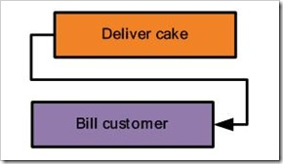
Start-to-finish (SF)
This type of dependency turns most people's concept of predecessor and successor tasks upside down. The confusion occurs because in most start-to-finish cases, the predecessor occurs after the successor. So, the start of the predecessor controls the finish of the successor.
This means that as long as A has started, we can proceed to finish B.
Activity A must start before Activity B can finish.

Slide 43
Examples of S-F
Say you’re building a new gas pipeline. You would first finish construction and implementation of the new pipeline before you would begin shutting down and breaking down the old pipeline
Similarly, implementation of a new accounting system has to be completed before you can begin turning off the old system
The start of the new shift of the security guard signal the finish shift of the current security guard. ie. if the next shift security guard didn't turn up, the first shift security guard has to continue his duty.

Slide 45
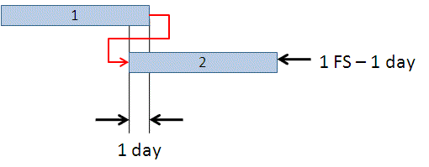
Lead Time- is overlap between tasks that have a dependency.
For example, if a task can start when its predecessor is half finished, you can specify a finish-to-start dependency with a lead time of 50 percent for the successor task. You enter lead time as a negative value in MS Project.

Slide 46
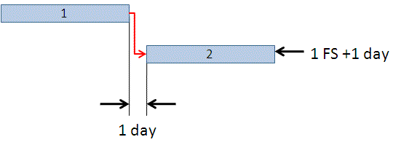
Lag Time- is a delay between tasks that have a dependency.
For example, if you need a two-day delay between the finish of one task and the start of another, you can establish a finish-to-start dependency and specify two days of lag time. You enter lag time as a positive value in MS Project

Slide 47
Gantt Chart- Using a Software (Project Libre)

Slide 48
Scheduling and Software
Time (week 4 and 5)
Quality
Cost
Scope
Plan Schedule Management
Define activities
Estimate durations
Sequence activities
Develop schedule
There are lots of different software that can be used to help with scheduling your project.
Scheduling uses the WBS as this lists the tasks/activities
However, the schedule also needs the time estimations for each activity
Estimating durations of tasks on projects is easy when the project is a “painting by numbers” (Maylor, 2017 and Obeng, 1995) project as the tasks are well-known.
Other types of project like Maylor’s As… But… and First Timers (Maylor, 2017) and Quests, Movies and Walking in the Fog (Obeng, 1995) are more difficult to estimate.

Slide 49
011 Individual Assignment

Slide 50
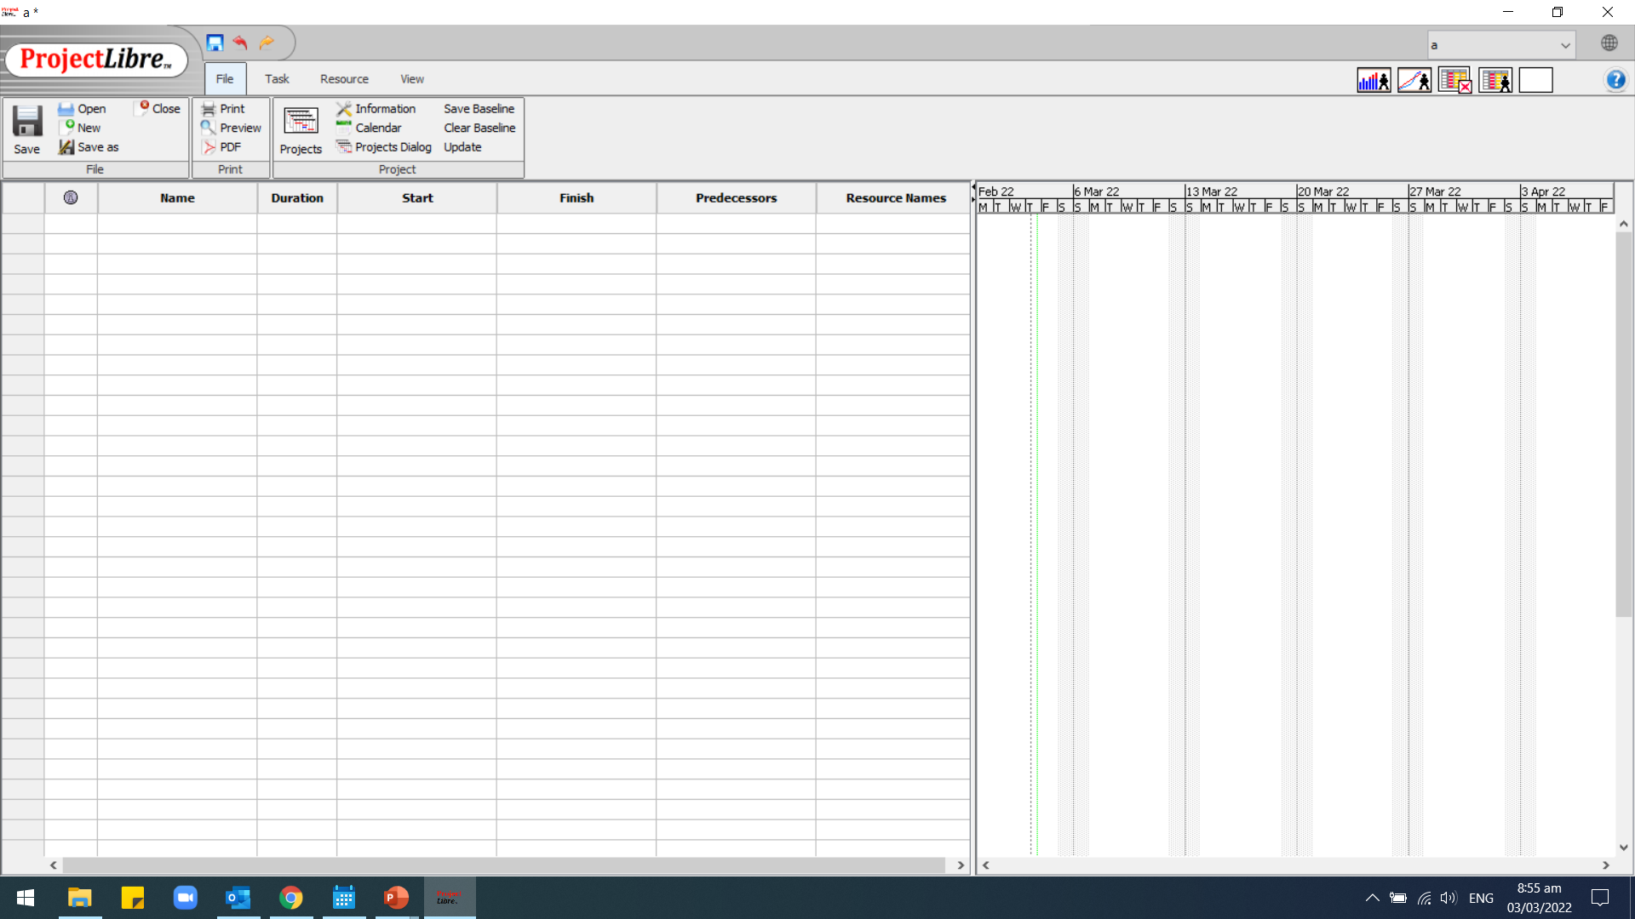
This week’s Project software task… all about accessing software
Download Project Libre from https://www.projectlibre.com/

Slide 51
Part 2. b Gantt Chart
Develop Dependency Table
Using the details from The implementation of the Yakoke’s Project Planning Approach section in the case study pg. 5-7
Identify the tasks, durations, predecessors
Use the Part 2.b and c Guide document to record your details. Available on SAM VLE

Slide 52
Summary
Addressed the following aspects…
Planning gives a deeper understanding of the project, but plans need to be adapted.
Stakeholder engagement is vital for requirements collection and measuring quality
Projects can spiral out of control through scope creep – this needs active management
WBS shows the scope of the project and divides the work into manageable tasks
Quality standards that can be measured aid in bridging the gap between expectation and perception.
Scheduling needs the task information, durations and resources.
MS Project is a software for scheduling and managing projects

Slide 53
Self-managed Study
Read Chapter 5: Initial Planning and Chapter 9: Stakeholders of Maylor (Kortext)
Have a go at the practice quiz
Work on:
Task 1 Reflection on Your Project Management Knowledge and Skills (15%)
Task 2.b Gantt Chart

Slide 54
Any questions
?
?
?
?
?
?
?

Slide 55
References
Hughes, K. 2018. 25 of the Best Planning Quotes [online] Project Manager, Available at: <https://www.projectmanager.com/blog/planning-quotes> [Accessed 18 May 2021].
Maylor, H. 2017. Project Management 4th ed. Harlow: Pearson Education
Project Management Institute, 2017. A Guide to the Project Management Body of Knowledge, PMBOK Guide 6th ed. Newton Square, Pennsylvania: Project Management Institute Inc.
Project Management Institute, 2021. A Guide to the Project Management Body of Knowledge, PMBOK Guide 6th ed. Newton Square, Pennsylvania: Project Management Institute Inc.
Obeng, E. 1995. All Change!: The Project Leader's Secret Handbook. Harlow: Financial Times Series
Viter, I. 2021. The Ultimate Guide to Scope Creep [Updated for 2021] [online] Project Management Institute. Available at: <https://www.forecast.app/blog/scope-creep> [Accessed 18 May 2021].

